Slide 1
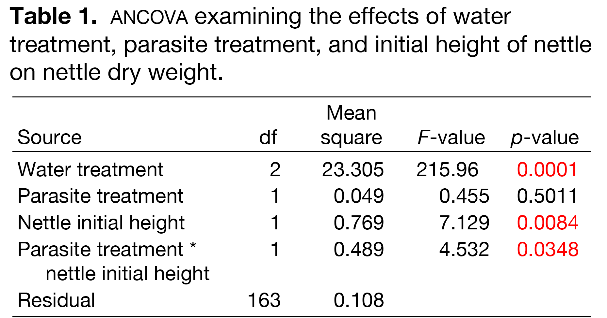
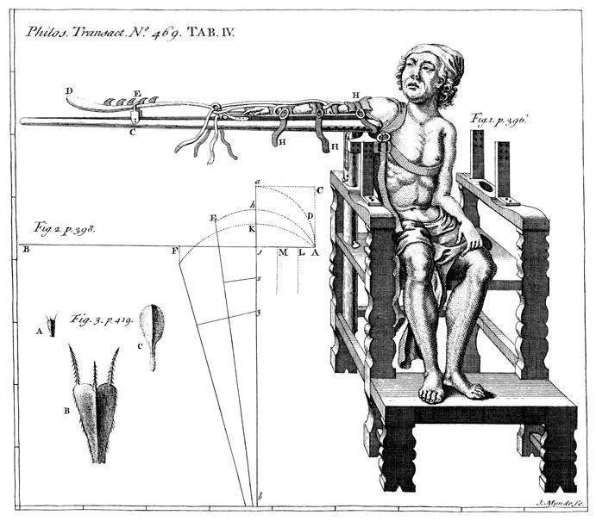
Title that hints at the underlying
issue or question
Your Department, Your organisation, Country
Your Logo
Putting titles on graphs makes your graph instantly understandable to your viewers. E.g., just TELL your viewers what’s so cool or important about the graph…don’t make them hunt for it.
Introduction
This is a Microsoft Powerpoint template that has column widths and font sizes optimized for printing a 36 x 56” poster—just replace the “tips” and “blah, blah, blah” repeat motifs with actual content, if you have it. Try to keep your total word count under 500 (yes, this suggestion applies to everyone, even you). More tips can be found at “Designing conference posters” at
http://colinpurrington.com/tips/academic/posterdesign
Blah, blah, blah. Blah, blah, blah. Blah, blah, blah. Blah, blah, blah. Blah, blah, blah. Blah, blah, blah. Blah, blah, blah. Blah, blah, blah. Blah, blah, blah. Blah, blah, blah. Blah, blah, blah. Blah, blah, blah. Blah, blah, blah. Blah, blah, blah. Blah, blah, blah. Blah, blah, blah. Blah, blah, blah. Blah, blah, blah. Blah, blah, blah. Blah, blah, blah. Blah, blah, blah. Blah, blah, blah. Blah, blah, blah. Blah, blah, blah. Blah, blah, blah. Blah, blah, blah. Blah, blah, blah. Blah, blah, blah. Blah, blah, blah. Blah, blah, blah. Blah, blah, blah. Blah, blah, blah. Blah, blah, blah. Blah, blah, blah. Blah, blah, blah. Blah, blah, blah..
Pithed rats took longer to navigate maze
Time (s)
pithed
unpithed
Maze difficulty index
Figure 4. Label the lines manually (as above) and then delete the silly key provided by your charting software. The above figure would also be greatly improved if I had the ability to draw mini rats with and without brains.
Figure 1. Photograph or drawing of organism, chemical structure, or whatever…that might help lure people to your poster. Don’t use graphics from the web (they usually look terrible when printed).
Be sure to separate figures from other figures by generous use of white space. When figures are too cramped, viewers get confused about which figures to read first and which legend goes with which figure.
Figures are preferred but tables are sometimes unavoidable. A table looks best when it is first composed within Microsoft Word, then “Inserted” as an “Object.” If you can add small drawings or icons to your tables, do so!
Blah, blah, blah. Blah, blah, blah. Blah, blah, blah. Blah, blah, blah. Blah, blah, blah. Blah, blah, blah. Blah, blah, blah. Blah, blah, blah. Blah, blah, blah. Blah, blah, blah. Blah, blah, blah. Blah, blah, blah. Blah, blah, blah. Blah, blah, blah. Blah, blah, blah. Blah, blah, blah. Blah, blah, blah. Blah, blah, blah. Blah, blah, blah. Blah, blah, blah.
Materials and methods
Be brief, and opt for photographs or drawings whenever possible to illustrate organism, protocol, or experimental design. Viewers don’t actually want to read about the gruesome details, however fascinating you might find them.
Blah, blah, blah. Blah, blah, blah. Blah, blah, blah. Blah, blah, blah. Blah, blah, blah. Blah, blah, blah. Blah, blah, blah. Blah, blah, blah. Blah, blah, blah. Blah, blah, blah.
Blah, blah, blah. Blah, blah, blah. Blah, blah, blah. Blah, blah, blah. Blah, blah, blah. Blah, blah, blah.
Blah, blah, blah. Blah, blah, blah. Blah, blah, blah. Blah, blah, blah. Blah, blah, blah. Blah, blah, blah. Blah, blah, blah. Blah, blah, blah. Blah, blah, blah. Blah, blah, blah.
Put a figure here that explores one particular outcome in a complicated table of results.
The presence of this band confirms that X is true.
Figure 2. Illustration of important piece of equipment, or perhaps a flow chart summarizing experimental design. Scanned, hand-drawn illustrations are usually preferable to computer-generated ones. Just bribe (cookies, whatever) an artist to help you out.
Figure 5. You can use connector lines and arrows to visually guide viewers through your results. Adding emphasis this way is much better than making the point with words in the text section. Especially useful for when you cannot be at poster to guide viewer.
Results
The overall layout for this section should be modified from this template to best show off your graphs and other result-related illustrations. You might want a single, large column to accommodate a big map, or perhaps you could arrange 6 figures in a circle in the center of the poster: do whatever it takes to make your results graphically clear. And, by all means PLEASE, make your graphs big enough to read from 6’ away.
Paragraph format is fine, but sometimes a simple list of bullet points can communicate results more effectively:
9 out of 12 brainectomized rats survived (fig. 3a)
Brainectomized rats ate less (fig. 3b)
Control rats completed maze faster, on average, than rats without brains (fig. 3c) (t = 9.84, df = 21, p = 0.032)
Conclusions
Conclusions should not be mere reminders of your results. Instead, you want to guide the reader through what you have concluded from the results. What is the broader significance? Would anyone be mildly surprised? Why should anyone care? This section should refer back, explicitly, to the “burning issue” mentioned in the introduction. If you didn’t mention a burning issue in the introduction, go back and fix that -- your poster should have made a good case for why this experiment was worthwhile. A good conclusion will always refer to the literature on the topic -- how does your research add to what is already published on the topic?
Blah, blah, blah. Blah, blah, blah. Blah, blah, blah. Blah, blah, blah. Blah, blah, blah. Blah, blah, blah. Blah, blah, blah. Blah, blah, blah. Blah, blah, blah. Blah, blah, blah. Blah, blah, blah. Blah, blah, blah. Blah, blah, blah. Blah, blah, blah. Blah, blah, blah. Blah, blah, blah. Blah, blah, blah. Blah, blah, blah. Blah, blah, blah. Blah, blah, blah.
Blah, blah, blah. Blah, blah, blah. Blah, blah, blah. Blah, blah, blah. Blah, blah, blah. Blah, blah, blah. Blah, blah, blah. Blah, blah, blah.
(a)
(b)
(c)
Literature cited
Bender, D.J., E.M Bayne, and R.M. Brigham. 1996. Lunar condition influences coyote (Canis latrans) howling. American Midland Naturalist 136:413-417.
Brooks, L.D. 1988. The evolution of recombination rates. Pages 87-105 in The Evolution of Sex, edited by R.E. Michod and B.R. Levin. Sinauer, Sunderland, MA.
Scott, E.C. 2005. Evolution vs. Creationism: an Introduction. University of California Press, Berkeley.
Society for the Study of Evolution. 2005. Statement on teaching evolution. < http://www.evolutionsociety.org/statements.html >. Accessed 2005 Aug 9.
Figure 3. Make sure legends have enough detail to explain to the viewer what the results are, but don’t go on and on. Note that for posters it is good to put some “Materials and methods” information within the figure legends or onto the figures themselves—it allows the M&m section to be shorter, and gives viewer a sense of the experiment(s) even if they have skipped directly to figures. Don’t be tempted to reduce font size in figure legends, axes labels, etc.—your viewers are probably most interested in reading your figures and legends!
Acknowledgments
We thank I. Güor for laboratory assistance, Mary Juana for seeds, Herb Isside for greenhouse care, and M.I. Menter for questionable statistical advice. Funding for this project was provided by the Swarthmore College Department of Biology, a Merck summer stipend, and my mom. [Note that people’s titles are omitted.]
Often you will have some more text-based results between your figures. This text should explicitly guide the reader through the figures.
Blah, blah, blah (Figs. 3a,b). Blah, blah, blah. Blah, blah, blah. Blah, blah, blah. Blah, blah, blah. Blah, blah, blah. Blah, blah, blah. Blah, blah, blah.
Blah, blah, blah. Blah, blah, blah. Blah, blah, blah. Blah, blah, blah. Blah, blah, blah. Blah, blah, blah. Blah, blah, blah. Blah, blah, blah (Fig. 3c). Blah, blah, blah. Blah, blah, blah. Blah, blah, blah. Blah, blah, blah. Blah, blah, blah. Blah, blah, blah (data not shown).
Blah, blah, blah. Blah, blah, blah. Blah, blah, blah. Blah, blah, blah. Blah, blah, blah. Blah, blah, blah. Blah, blah, blah. Blah, blah, blah. Blah, blah, blah. Blah, blah, blah (God, personal communication).

