Slide 1
What’s *New* in the GAM?!
OVERVIEW
* As of March 2021

Slide 2
FEEDBACK:
Hugely positive from NGOs, some UN Agencies & reviewers:
Helps users understand HOW to be gender-response/ do GEP
Team building around gender, learning by doing
Better quality programs based on knowledge and understanding
Useful performance information at agency, country & global level
But…
WAAAAAY too long; repetitive; too much writing
Does not include people with disabilities
Lack of clarity on targeted/ transformative programming
Wildly inaccurate LGBTI info
Reports not available from the practice system
Notes:
This powerpoint provides an overview of the changes incorporated into the revised questionnaire, which will replace the existing one IN MARCH.

Slide 3
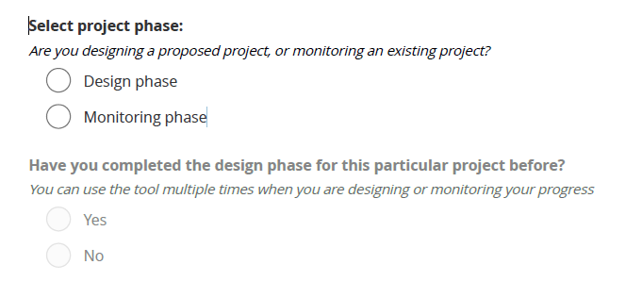
Notes:
This one change at the start of the revised questionnaire will eliminate a lot of “rubbish data” that gets entered by people “trying it out,” and also allow people to generate reports from their practice sessions.

Slide 4
Main changes. . .
Design Phase Needs Analysis (At the beginning of this section!)
>> GEM A: Analysis
Briefly describe gender, age and/or other inequality in this context: who is disadvantaged and why? (Do not write about your policy or project plans) (Max 150 words)
Notes:
Asking for the analysis at the beginning increases the likelihood that people keep these differences in mind as they think about tailoring their activities, how different groups will participate, and how benefits will be measured.
MOST projects to date have been simply described their gender policy or made promises about their plans – less than 30% actually articulate gender differences that should form the basis for responsive implementation. In testing the revised questionnaire, this wording has increased the proportion of projects describing actual role/power differences in their context.
This is the only “mandatory” narrative required in the revised questionnaire. Others are “recommended” but optional.

Slide 5
Design Phase Needs Analysis
>> GEM A: Analysis (continued)
The analysis considers the situation of LGBTI /other gender groups (lesbian, gay, bisexual, transgender, intersex: people with diverse sexual orientation, gender identity, gender expression, and/or sex characteristics)
Yes
No / Not yet
The analysis is particularly concerned about the situation of the following gender group(s): (Females, Males, LGBTI, All gender groups)
The analysis is concerned… “ “ …age groups: (incl All age groups)
The analysis is particularly concerned about the situation of the following group(s) with disabilities (females with disabilities; males “ “; all gender groups with disabilities; people with disabilities but gender not specified)
Notes:
Asking whether the project considers LGBTI people in the analysis section means this choice may not open in subsequent questions. In the old questionnaire, about 30% of projects tick the boxes saying they serve LGBTI, but project narratives suggest the reality is only about 2%.
Gender and age sections remain basically unchanged.
“ALL gender groups” and “ALL age group” boxes have been added to eliminate the need (for most projects) to tick 9 separate boxes on each question - though the individual gender and age selections remain available, of course.

Slide 6
10 Indicators of good programming:
Gender Equality Measures (“GEMs”)
Design Phase
Monitoring Phase
A
Gender Analysis
B
Disaggregated Access Data
The issues facing females, males and LGBTI in different age and/or disability groups are understood and described
Different groups of people are able to access assistance
D
Tailored Activities
E
GBV Protection
Females, males, all gender groups of different ages and/or disabilities get the assistance they need
People are safer
G
Influence
H
Feedback & Complaints
I
Communication with Communities
Females and males in appropriate age and/or disability groups influence decisions throughout the project
People can complain and be heard
People get the information they need
J
Benefits
K
Satisfaction
L
Project Problems
Different groups of concern (gender, age, disability) get different benefits; no one will be left behind
Different people are satisfied
Problems are known and addressed
Notes:
The questionnaire still steps users through TEN key elements of good programming, in each case asking about gender, age, and people with disabilities.
Removed GEM C – Good Targeting – this asked about which gender/age groups were getting less than planned, duplicating Monitoring GEM J benefits, “who’s missing out.”
Removed F – Coordination – this asked what kind of information was shared in clusters and how it was disaggregated, and produced unrealistically optimistic responses.
Monitoring GEM B – will now ask about Disaggregated Access Data – what kind of ‘beneficiary’ numbers are being used (actual or population estimates), whether this is analyzed, and how access information is disaggregated (sex, age, PWD)

Slide 7
Notes:
Uses plainer language – previous wording of “roles and dynamics” appears to have been misunderstood.
The answer choice used to identify targeted actions – “tailored solely to address gender-based discrimination” – is unchanged and appears to work well; consistently about 3% of projects are “T,” targeted actions.
(GEM D continues on next slide)

Slide 8
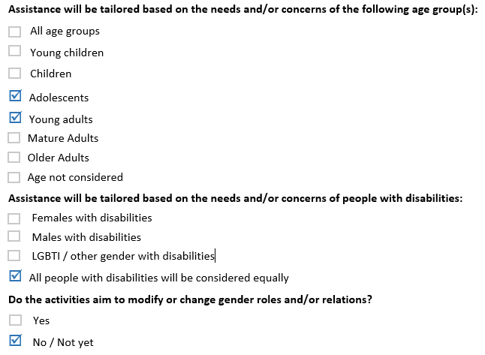
Notes:
As before, questions about gender are followed by age, then people with disabilities, plus a new question on intended “transformative actions.”

Slide 9
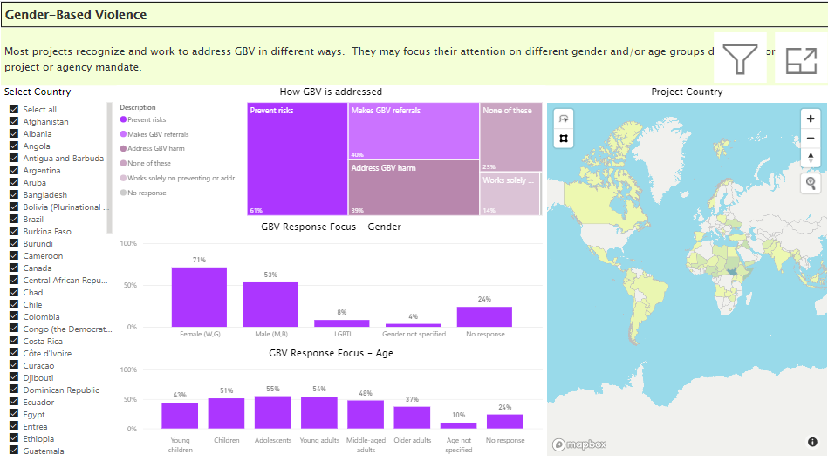
Results are available on the GAM dashboard,
where we can compare e.g., global GBV response in projects…
Notes:
A link to the dashboard in development was shared via email (write to iasc-gam@un.org) if you need it again. The dashboard will be linked to the GAM website when final.

Slide 10
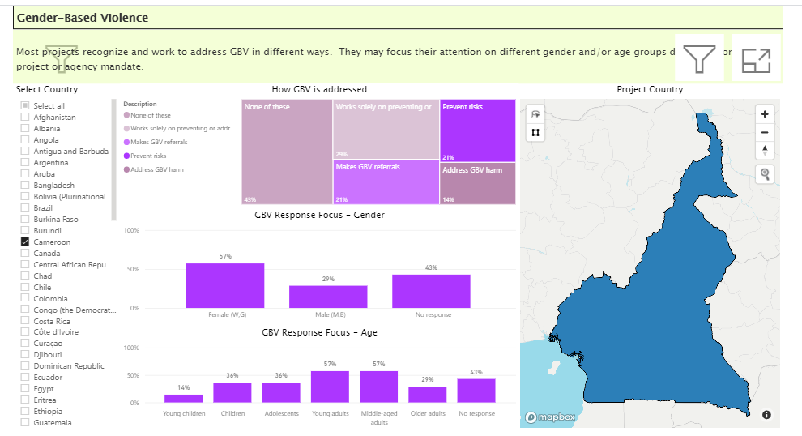
…with how projects in a particular country are responding

Slide 11
What to work on?
The most useful entry point for advisors and focal point to improve attention to gender and inclusion continues to be in reviewing the narratives submitted by projects or clusters, “Briefly describe your gender analysis / your analysis of who is marginalized and why,” in their project/sector GAM Report.
If people cannot describe existing inequalities, they will be unlikely to use this information to tailor their interventions.
Use the dashboard to identify areas for improvement – e.g. more accessible complaints mechanisms, better communication with different groups, or to highlight a potentially underserved age group

Slide 12
Status at Feb 2021
Programming of the revised questionnaire is ongoing & due soon
The revised Design Phase has been used/tested well in several countries (~1350 forms completed)
When the Monitoring Phase questionnaire is finished and translated, the dashboard will be revised to accommodate the changes and merge existing GAM data (~13,000 ‘old’ forms)
A dashboard link will be added to the GAM website, ideally with a “cluster/sector” filter. A planned secure access section should be developed to allow organizations to filter for their own results.
A podcast will be added to the website for people wanting a spoken orientation / introduction
Management of the GAM has been handed over to OCHA Gender Equality Unit (GEU). GEU has been responding to GAM ‘help’ emails (iasc-gam@un.org) since last year.

